Slide 1
Prematurity Is For Life Not Just The Neonatal Unit
Mandy Daly
Advocacy & Policymaking
Irish Neonatal Health Alliance

Slide 2
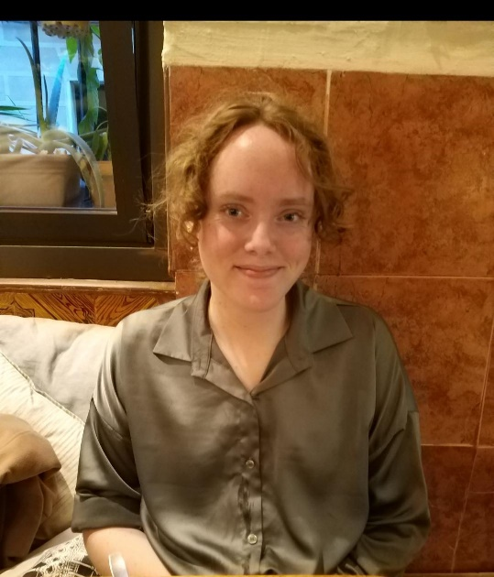
Unexpected Connections

Slide 3
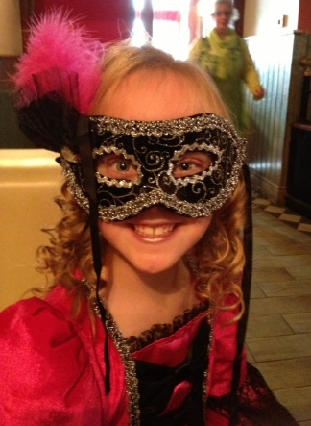
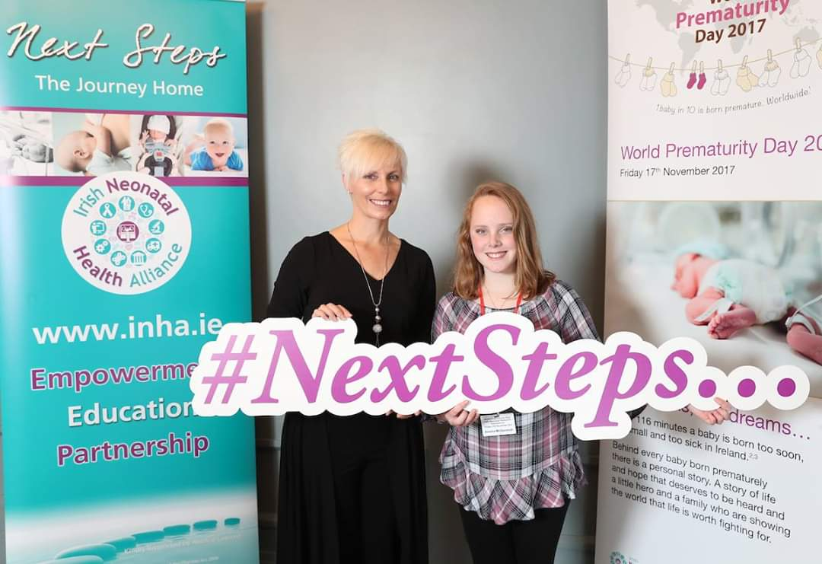
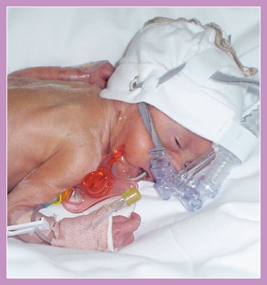
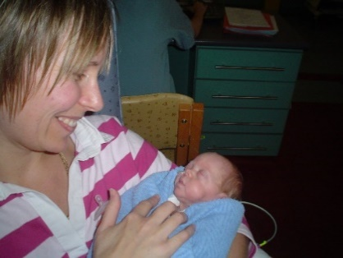
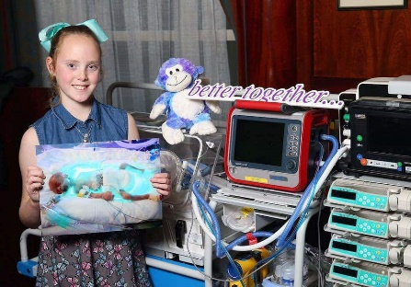
It’s Not Always What You See
Adulthood
Young Adult
Early Childhood
Neonatal
Antenatal
Pre-Conception
Notes:
PTB is a journey not just an event. With ptb, what you see in a particular moment of time if most definitely not the entire picture. PTBs are the epitome of complexity when you consider the journey that many of them particularly the VEPTBs have been on and not to mention the external factors that also contribute to the picture ie. The parental journey and parental experience and how that influences the outcomes for our PTBs. When does the continuum of care start? Who is responsible. Is the responsibility shared throughout the life of the ptb, is it passed on etc?

Slide 4
“The Beginning Is The Most Important Part Of The Work” - Plato
1st Trimester
2nd Trimester
3rd Trimester
Pre-Conception
Notes:
**Care is a collaborative & dynamic process and includes elements such as education and action. Similar to mathematics, if we miss some of the fundamental information, some of those foundational building blocks the resulting structure is never going to be as strong as it might have been. Pre-conception education gaps continue to exist and it requires a broad range of stakeholders to address this deficit ie education for both families and hcps. Primary & 2nd level lectures, presenting to nursing, ahp and medical students, public awareness campaigns, normalising the conversation around PTB.
The antenatal period can be challenging time for clinicians in terms of discussing potential adverse events but increased public awareness around the risks associated with PTB, the care pathways that exist in the event of a PTB and the role that both HCPS and families can play in that care pathway serve to improve outcomes of our babies born to early.

Slide 5
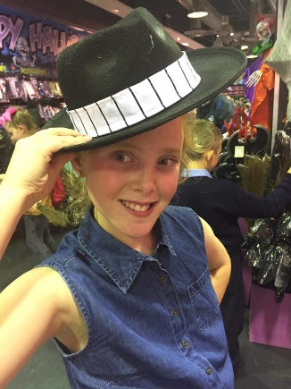
Early Years
Discharge
Sensory
Speech & Language
Motor Skills, Executive Function
Sleep
Feeding
BPD
Anxiety
Mental Health
Notes:
Discharge from NICU. Community supports. Isolation. Loss of safety net. PHN network. GP network. NOT fitting in anywhere. Always different. Parental wellbeing
Discharge from follow up at age 2. Cast adrift. Unresolved issues. Emerging issues. Parental lack of knowledge. Lack of guidance. Not being heard, being dismissed as over anxious. Delays in diagnosis and early intervention..lack of appropriate intervention. Disciplines not working around the same table together
Pain,*Sensory – sight, hearing, touch, taste, smell, vestibular, Proprioception- constant movement, to concentrate
Speech and language,Motor skills fine and gross, executive function. These skills underlie the capacity to plan ahead and meet goals, display self-control, follow multiple-step directions even when interrupted, and stay focused despite distractions, among others.*BPD/sleep,Feeding/meds,Anxiety,Parental Mental Health,Haemangioma

Slide 6
Challenges To Quality Feeding and/or Sleep
BPD NEC ROP
Positioning
School
Sleep
Feeding
Energy
Neuro-development
Family Wellbeing
Notes:
Mandy

Slide 7
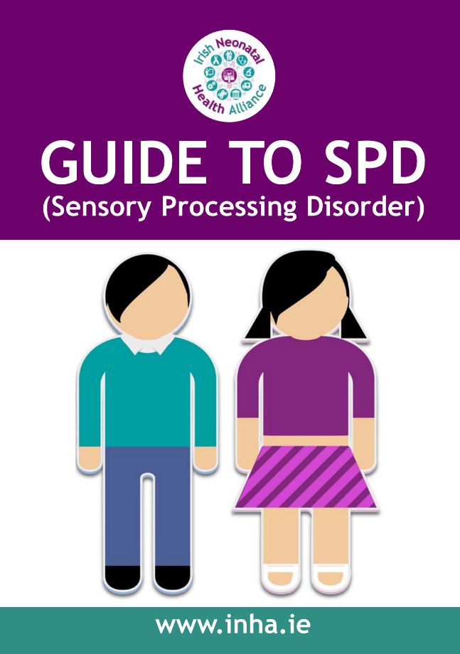
Sensory processing disorder (SPD)- the inability to use information received through the senses in order to function smoothly in daily life.
SIGNS OF SENSORY PROCESSING DISORDER
Notes:
Boris

Slide 8
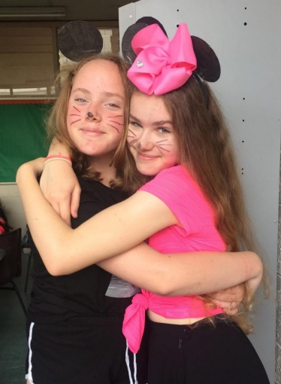
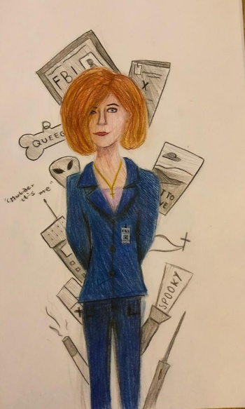
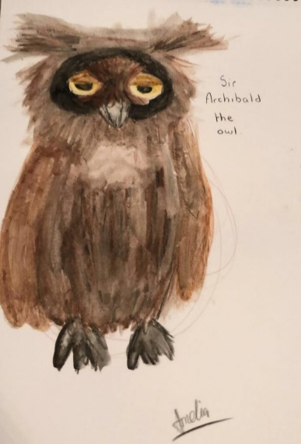
Young Adult
BPD
Pain
Dyspraxia, Executive Function
Cardiac
Sensory
Circulation
School
Anxiety
Feeding
Notes:
BPD, pain, sensory and its affects on self esteem- self awareness, frustration at not being heard or believed by others.Motor skills. Dyspraxia. EF
Learns differently, sees problems differently, needs sound in order to concentrate, frustrated by math. Anxious
Haemangioma/circulatory issues in foot- old ladies feet. Cardiac issues. Feeding,Struggle to be heard by community based gp services

Slide 9
What Research Is Telling Us
Dr. Saroj Saigal Longitudinal Studies, assessment measures:
Childhood: cognition, school achievement, executive function and behaviour.
Adolescence: accomplishments, independence, self-perception, mental
health, quality of life & future aspirations.
Adulthood: cardio-vascular system & metabolic sequelae, psychiatric disorders, visual problems & reproduction.
Saigal et al, longitudinal studies (0-36 years)

Slide 10
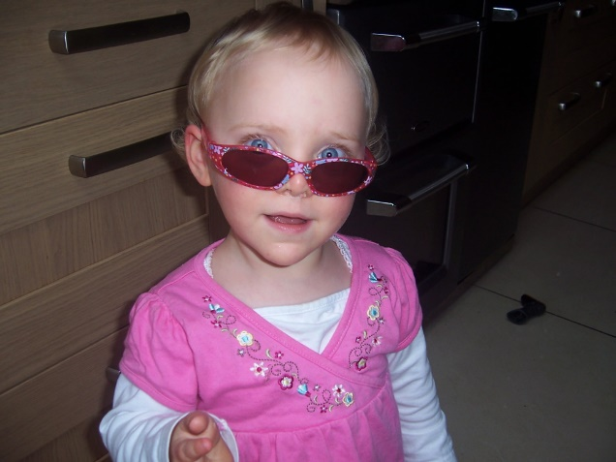
Early Years
First 2 years development of very early PTB is mildly delayed.
10% diagnosed with neurological problems.
Delays in language skills is very common.
Behavioural problems.
Saigal et al, J Pediatr 1984; 105:969-967.

Slide 11
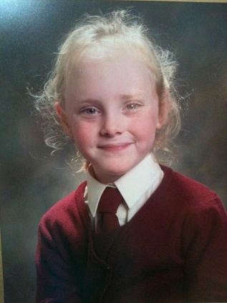
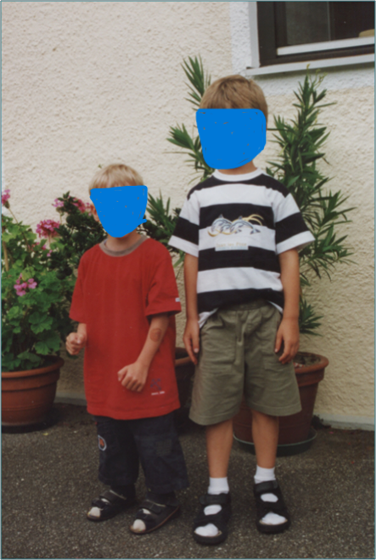
School Age Outcomes
PTB have lower IQ compared to full-term & one-quarter to one-third may present with learning difficulties; higher in EPT. 57% of PT 7 yr olds reach expected targets in reading, writing & maths compared with 82% of term infants.
Many children have difficulty in executive function.
Significant numbers required remedial assistance in school.
Behavioural problems i.e. ADD & ADHD particularly in boys.
Saigal et al, J Pediatr 1991; 118:751-760.

Slide 12
Educational Problems in Adolescence
Lower IQ and learning difficulties continue with learning difficulty rates that are substantially higher than term.
Major difficulties in math. (WWW.PRETERMBIRTH.INFO)
Prevalence of educational and learning difficulties at school age & adolescence far surpass rates of neurodevelopmental impairment in EPT/VPT infants.
Economic analyses has shown that after the NICU, the greatest costs associated with support for EPT infants lie in education.
Petrou S et al, ‘09
Saigal, 2003 ; Hutchinson 2013; Johnson S, 2011; Litt JS, 2012

Slide 14
Adulthood 29-36 Years
ELBW n=100 NBW n=8 P
Education 16.0 (2.6) 16.7 (3.2) NS
Employed in the last year (%) 80.4 91.8 .02
FT work in the last year (%) 61.5 76.6 .04
Total personal income 26,485 46,552 <.001
Total household income 54,450 76,148 <.001
** ELBW women were less likely to be working FT
Saigal et al, JAMA Ped, 2016

Slide 15
Bavarian VLBW: Neuro cognition, Age 26 Years
217 VLBW/VPT & 197 term controls born 1985/86.
IQ and executive function below the control group.
Multiple cognitive deficits present in 73% of VLBW compared with 49% of controls.
MRI studies showed decreased cerebral volume, loss of grey and white matter.
VLBW adults do not outgrow their earlier intellectual deficits & will continue to require more specific support from educational agencies.
Erygit MS et al, J Child Psychiatry. 2015;56:857-64

Slide 16
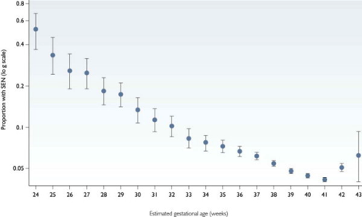
Correlation Between Outcomes & GA
Marlow 2005; Wolke 2000
McKay et al PLOS Medicine 2010

Slide 17
Norwegian PTB and Reproduction: National Birth Registry #Premature = 60,354(5.2%)
Still Birth rates at <28 weeks = 20.8/1000; Term = 7.6/1000 births.
Reproduction: Of those born <28 wks GA, only 25 % F & 14% M had reproduced vs Term 68% F & 50% M.
Recurrent Preterm Birth: Had increased risk of recurrent PTB with a GA dose response: 22-27 wks = 14%; Term = 6.4% Swamy et al, JAMA, 1429-36, 2008
Subsequent Pregnancies: Fewer after preterm birth (missing sibs). Finland, Alenius, 2018

Slide 18
Anthropometric Measurements at 29-36 Years
Parameters | ELBW | NBW | P
 | Mean | SD | Mean | SD
Height (m) | 1.64 | 0.10 | 1.71 | 0.11 | >0.001
Weight (kg) | 71.9 | 16.54 | 77.5 | 18.28 | 0.03
BmI (kg/m2) | 26.9 | 6.41 | 26.5 | 5.08 | 0.61
Mean difference 6.0 cm Ht and 5.6kg Wt
Morrison, Saigal, Pediatrics 2016;138:e210605

Slide 19
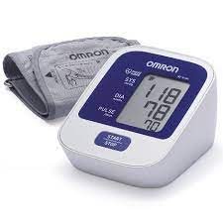
Blood Pressure of ELBW & NBW
ELBW n = 94 NBW n = 88
M (SD) M (SD)
______________________________________________________
Systolic BP mm Hg 113.8 (11.93) 108.9 (10.59)*
Diastolic BP mm Hg 73.7 (10.00) 70.05 (8.27)**
_______________________________________________________
*P .004; **P.02.
No differences in BP between AGA and SGA.
Mean difference: Systolic: 5mm Hg; Diastolic: 3.2 mm Hg.
A 5mm increase in systolic BP is associated with a 34% increase in mortality due to stroke and increased risk of IHD. Lewington et al, Lancet 2002

Slide 20
APIC Collaboration: Mean Differences in Young Adult BP in VPBW/ELBW vs NBW
ELBW Vs Control
Blood Pressure Group Mean Difference (95% CI)
_____________________________________________________________________________________________________
Systolic All 3.4 (2.0 – 4.8)*
Men 1.3 (-0.8 – 3.4)
Women 4.9 (3.0 – 6.8)*
_____________________________________________________________________________________________________
Diastolic All 2.4 (1.3 – 3.4)*
Men 2.1 (0.6 -3.5)*
Women 2.6 (1.2- 4.0)
_____________________________________________________________________________________________________
www.apic-preterm.org : International Data, including McMaster:#9 cohorts;
VLBW and 777 NBW
Hovi..Saigal et al, APIC collaboration. Hypertension 2016: 68:880-7.

Slide 21
McMaster Prevalence of Dysglycemia in ELBW compared with NBW
PreDiabetes
Type 2 DM
Dysglycemia
Prevalence
%
*P<.01
*P<.05
ELBW
NBW
*Glucose Imbalance
Morrison K, Saigal S, et al., Ped 2016:138:20160515

Slide 22
Mental Health In Adulthood
McMasters studies show a significant increase in non-substance abuse psychiatric disorders. Van Leishout, Saigal, 2015
Scandinavian National Registries confirm an increased risk of psychiatric disorders, ASD, ADHD that significantly impact daily life. Moster, NEJM 2008.
Swedish study of psychiatric hospitalisation reported an increased risk of psychosis, depressive & bipolar affective disorder & more frequently prescribed medications.Lindstrom, 2005; Nosarti C; Crump C, 2010; Saigal S, 2006

Slide 23
Psychiatric Diagnoses: IPD Meta-analysis
APIC participants: VP/VLBW = 1385; NBW = 1780 from 10 cohorts & 8 countries with structured measures of psychiatric diagnoses using *DSM or **ICD criteria.
Results: VPT vs NBW:
10x higher odds of ASD; higher with decreasing GA and in males.
5x the odds of ADHD.
2x more likely to have anxiety or depression.
1.5x the odds of mood disorders; more males affected.
Anderson,.. Saigal et al, eClinicalMed, 2021;41;10216
*Statistical Manual of Mental Health Disorders
**International Classification Of Disease
Notes:
Diagnostic and statistical manual of mental disorders

Slide 24
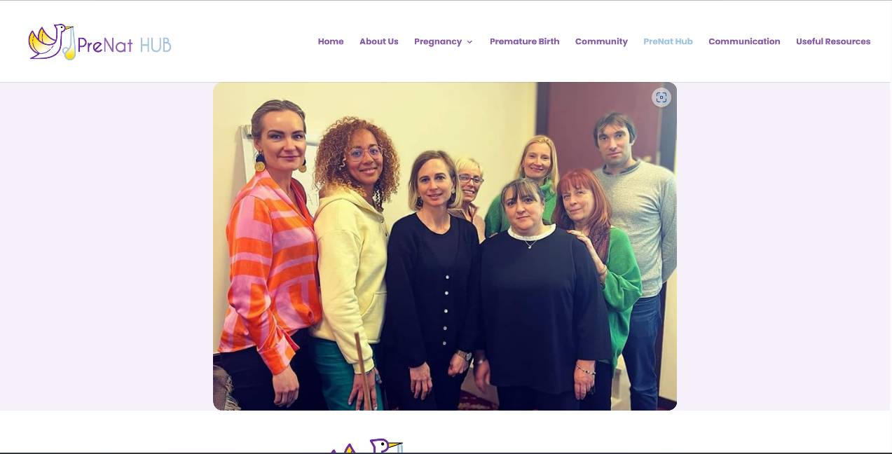
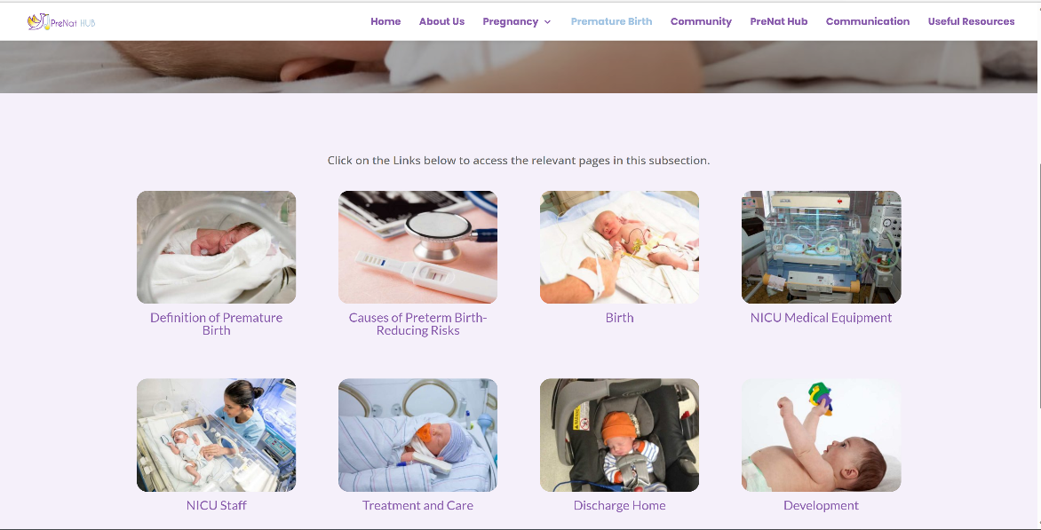
www.prenathub.ie

Slide 25
www.adultpreemies.com
ADULT PREEMIE ADVOCACY NETWORK
Notes:
Diabetes and Chronic Kidney Disease at 26 years old –I don’t believe I have Type 2 from years of tracking my glucose levels, but rather dysglycemia – which is more evident when stressed / tired.
My current health concerns revolve around the pre-eclampsia link – so blood pressure, potential cardio issues and massively increased risk of stroke – none of which is acknowledged – so importance of understanding birth history and possible implications in later life.
Also that all prem parents / adult prems have valid health concerns, rather than “health anxiety” / mental health issues.

Slide 26
Finding Their Voice
Cardiology
Neurology
Gastroenterology
www.adultpreemies.com
Opthalmology
Follow-Up
Renal
Immunology
Respiratory
Mental Health
Notes:
1751 visits
51 Countries and from every Continent. Most views from UK / USA / Europe / Canada.... but also China, Japan, Guatemala, Chile even Kyrgyzstan!!
Shows there is interest / people looking! Also validates what we are all doing.
Mostly found via search engines – so the onus is still on people to find us themselves.
FB groups combined have 315 members - we have 177 adult prems in the groups, again spread around the globe. FB isn’t as reliable, as people are free to come and go as they please – but we have had steady and continued growth for the past year.

Slide 27
Ongoing Research
Health of Adults Born Preterm - HAPP-e (Europe)
NeoWonder - linking Neonatal, Health & Educational records to improve outcomes. (UK)
RECAP – Developing a COS for future studies. (Europe)
Values & Preferences – preferences on the use of medications
for PTB. (Canada)

Slide 28
Ongoing Research Continued
Decision Making – how parents make decisions relating to EPTB. (USA)
BANNFU SIG looking at the journey from childhood to adulthood. (UK)
Defining What Matters After NEC (Netherlands).

Slide 29
Room To Improve
Improved ante-natal education – personal, professional, public.
Infant & Family Centred Developmentally Supportive Care.
Discharge as a Continuum of Care.
PTB does not disappear at age 2.
Lifelong follow-up. ? New subspecialty?
Community based education & upskilling for community health, educators, public.
Collaboration with ex-preterm infants.
Research
Notes:
IFCDC- family liaison
Discharge – dynamic, rehearsal, empowerment tool., neurodevelopment, sensory development,sleep, nutrition, positioning, situational awareness, cues, patient organisation, bridge the transition from nicu to home & community based care (who we have to upskill), measuring impact of discharge with QI initiatives.

Slide 30
Amelia’s Future
Adult ???
Young Adult √
Early Years √
Neonatal Unit √
Notes:
We have known for decades that there are life long issues for ptb but what we are not seeing is a translation into practice. Too often I hear clinicians and researchers say that they are reluctant to raise certain topics for fear of causing upset. Our adult preemies are now telling us that they want this information; they need this information so that they can make informed decisions about their lives. Its imperative that we continue to gather evidence but this must also be balanced with meaningful action. They do not want to be passive in this process. They want to and need to be part of the solution

Slide 31
“The Future Depends On What We Do In The Present”
Mahatma Gandhi

